Slide 1

Internationalization and Localization in Flutter Apps
Dheeraj Singh Bhadoria
@bhadoriadheeru
in/dheeraj-singh-bhadoria-android-developer

Slide 2
Internationalization and Localization in Flutter
Definition and importance of internationalization and localization in app development
Benefits of creating a multilingual app
Goals of the project

Slide 3
Importance of a Multilingual App
Expanding the user base and reaching a global audience
Enhancing user experience by providing content in their preferred language
Boosting user engagement and increasing app adoption

Slide 4
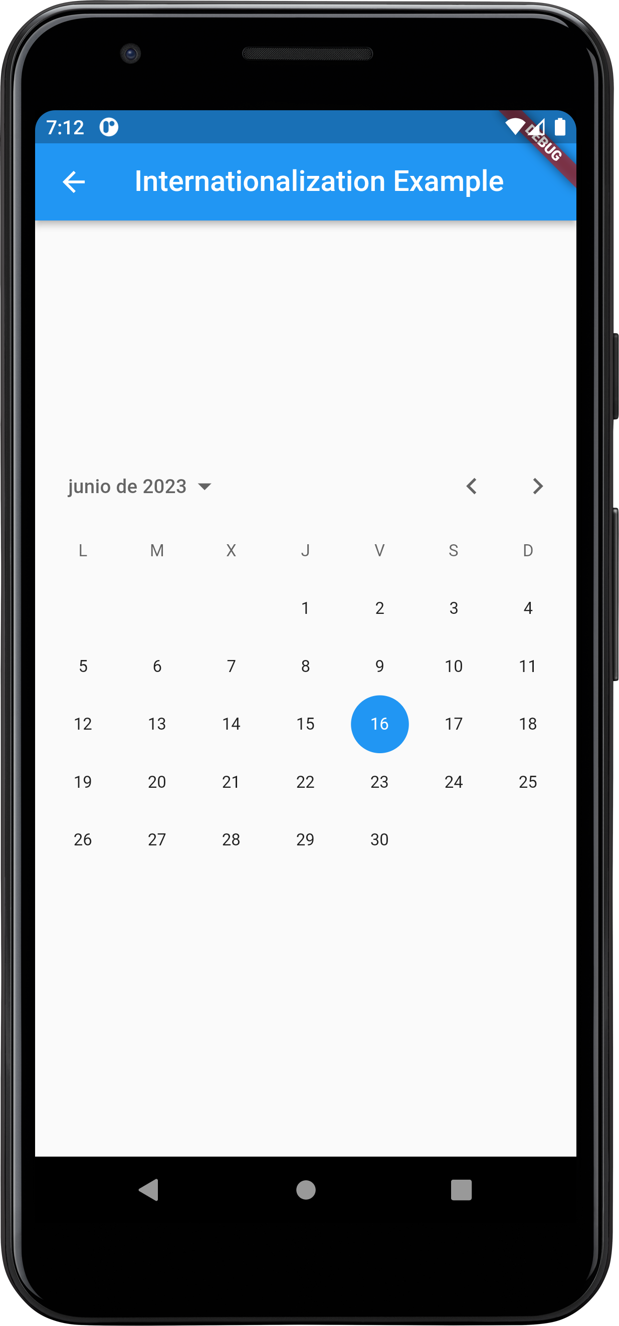
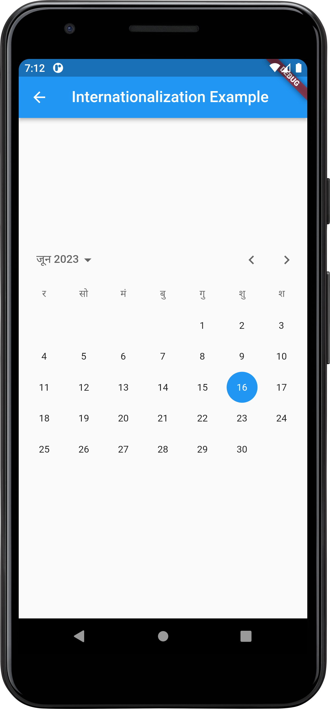

Internationalization Screen - Overview
English
Spanish
Hindi

Slide 5
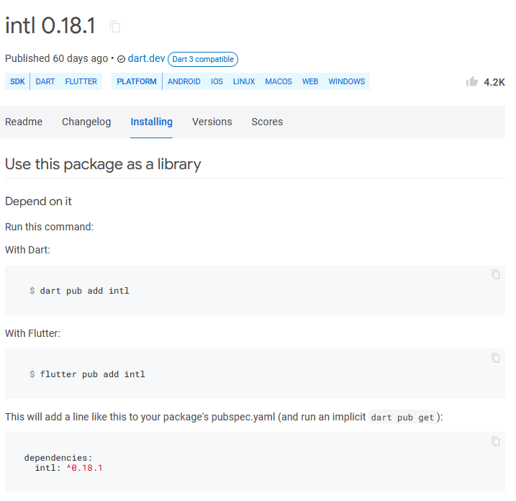
Implementing Internationalization in Flutter
Step 1: Adding the necessary package to enable internationalization

Slide 6
Implementing Internationalization in Flutter
Step 2: Implementing code changes to support multiple languages
Localizations.override( context: context, locale: const Locale('es'), // Using a Builder to get the correct BuildContext. // Alternatively, you can create a new widget and Localizations.override // will pass the updated BuildContext to the new widget. child: Builder( builder: (context) { // A toy example for an internationalized Material widget. return CalendarDatePicker( initialDate: DateTime.now(), firstDate: DateTime(1900), lastDate: DateTime(2100), onDateChanged: (value) {}, ); }, ), )

Slide 7
Implementing Internationalization in Flutter
Step 3: Showcasing the integration of a date picker widget with language support

Slide 8
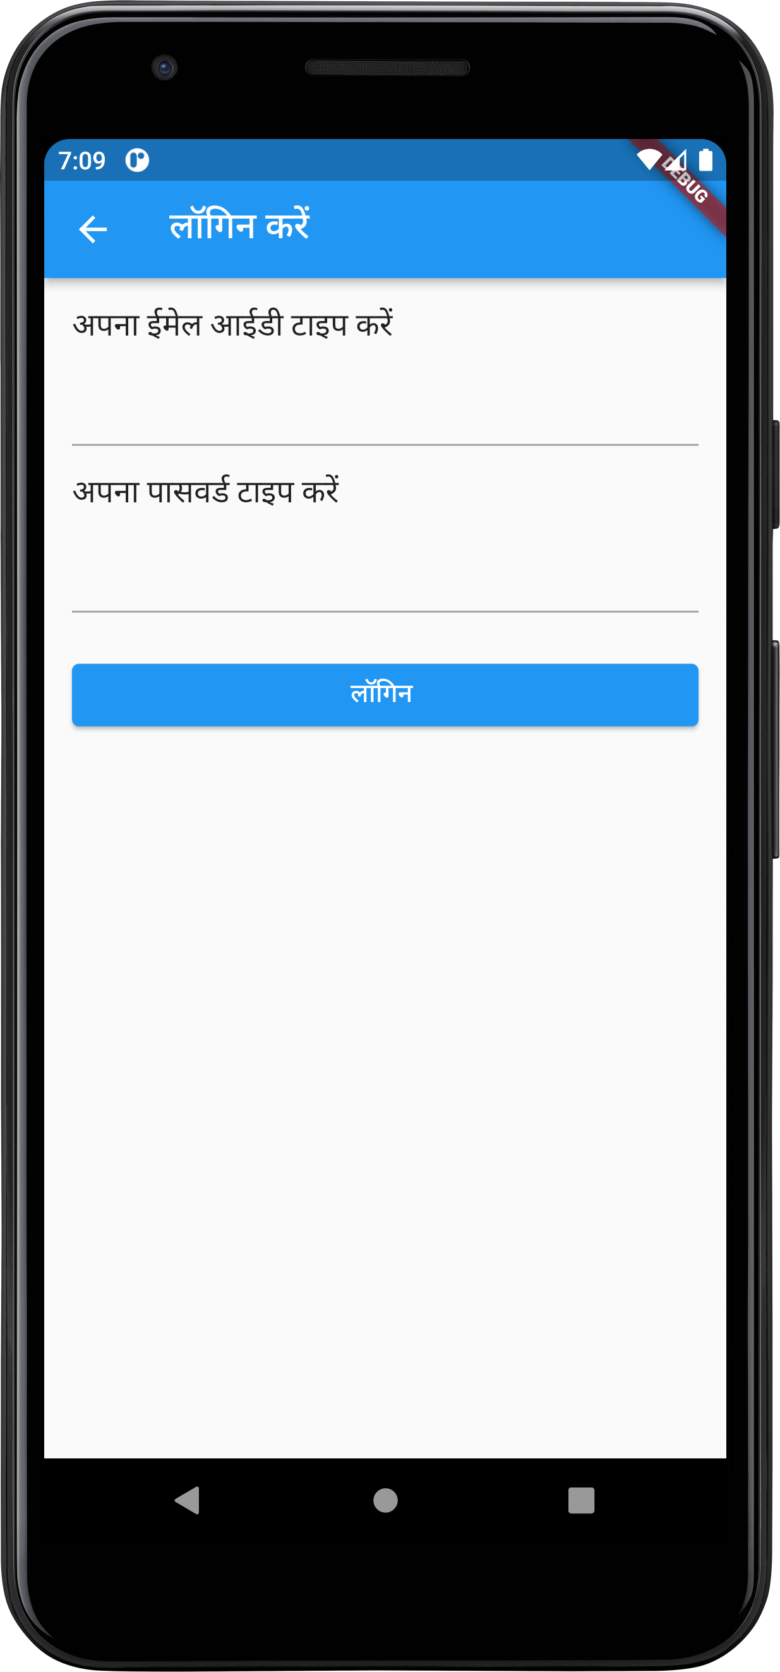
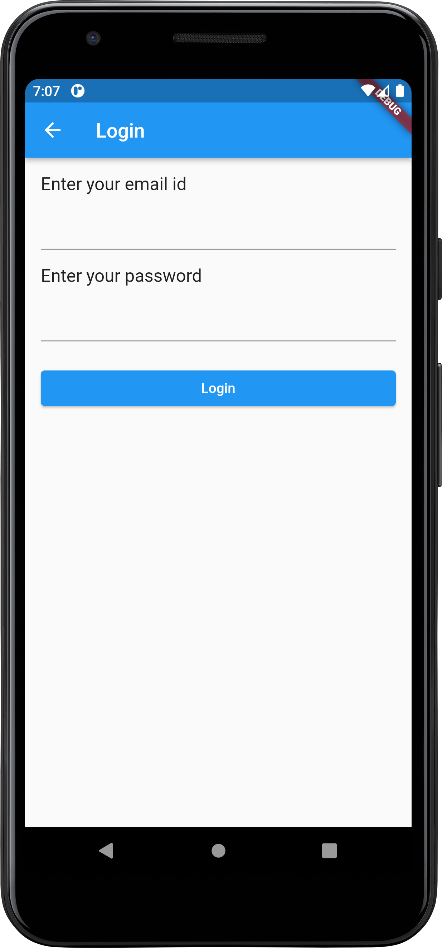
Localization Screen - Overview

Slide 9
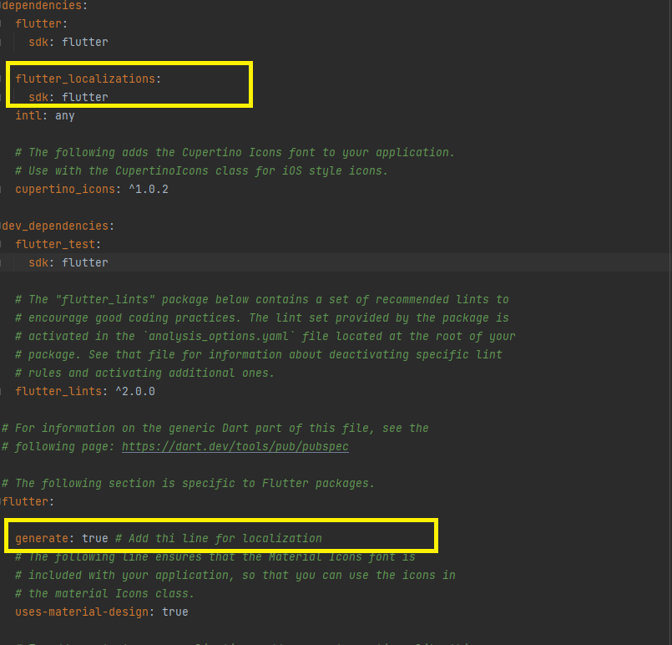
Implementing Localization in Flutter
Step 1: Adding the necessary localization package at pubspec.yaml

Slide 10
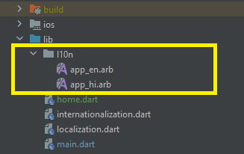
Implementing Localization in Flutter
Step 2: Creating the l10n folder structure and files (display a screenshot)

Slide 11
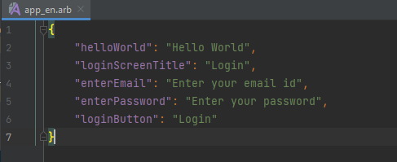
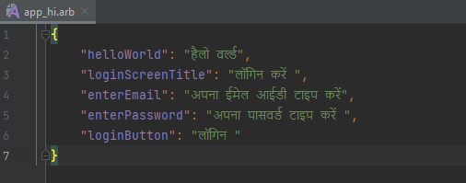
Implementing Localization in Flutter
Step 3: Adding resources files for different languages (display files)

Slide 12
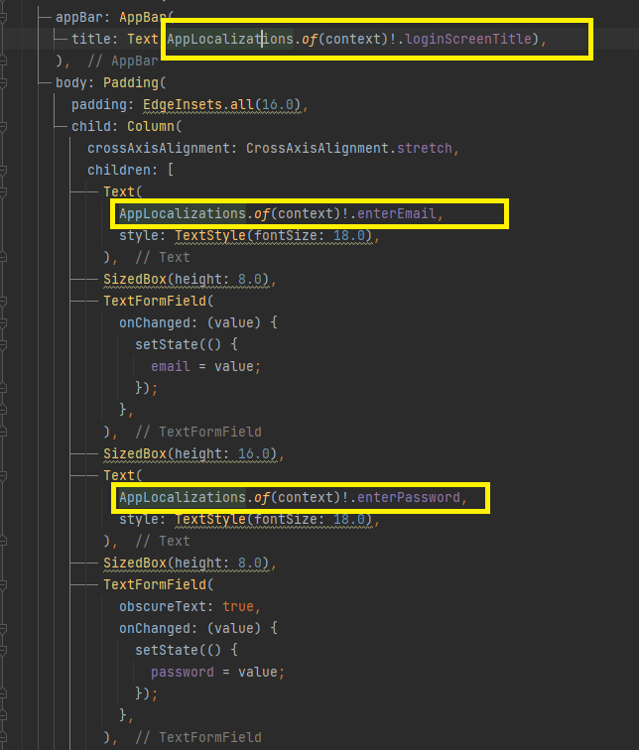
Implementing Localization in Flutter
Step 4: Displaying text from resources files in the app (display files)

Slide 13
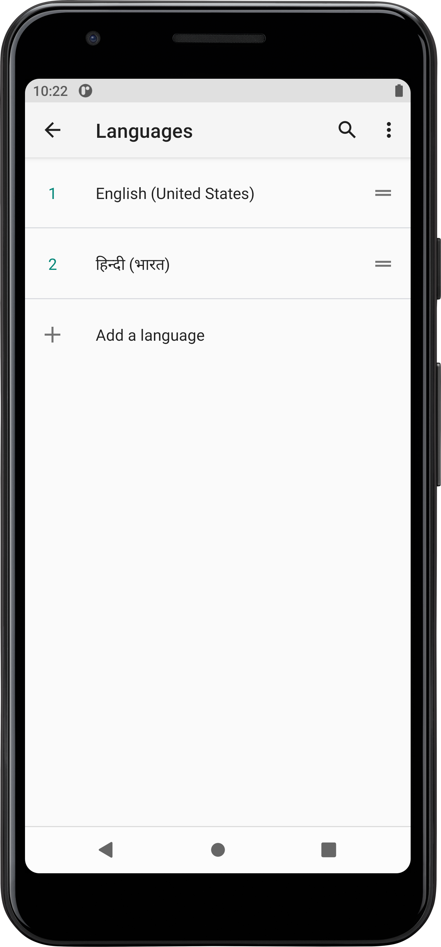
Implementing Localization in Flutter
Step 5: Demonstrating how changing the device language affects the app's text

Slide 14
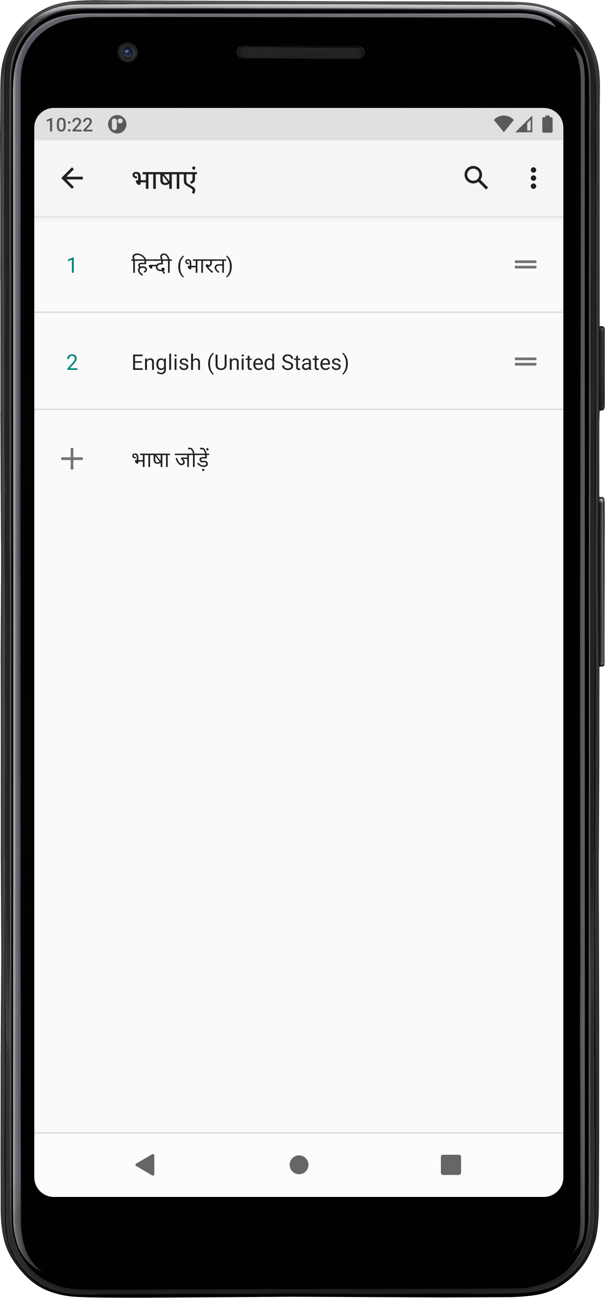
Implementing Localization in Flutter
Step 5: Demonstrating how changing the device language affects the app's text

